Slide 1
Métodos aproximados de cálculo estructural: Método de Muto
Análisis Estructural II
Ing° Alaín Elvis Alanoca Aragón

Slide 2
Propósito
Conocer el procedimiento de análisis estructural de pórticos en el plano bajo el efecto de cargas laterales por el Método de Muto.

Slide 3









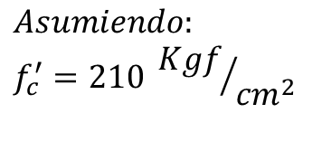
Ejemplo: Elaborar el diagrama de fuerzas cortantes y momentos flectores del pórtico usando el Método Muto
6500 Kgf
B
D
F
$$50 cm$$
$$2.8 m$$
$$30 cm$$
$$Asumiendo:$$
$$f_{c}^{′}=210 {Kgf}/{{cm}^{2}}$$
A
C
E
$$3.80 m$$
$$4.2 m$$
$$30 cm$$
$$30 cm$$
$$30 cm$$
$$30 cm$$
$$35 cm$$
$$45 cm$$

Slide 4
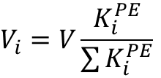


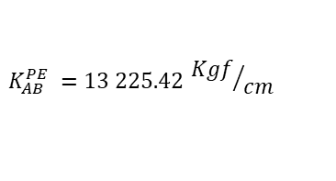


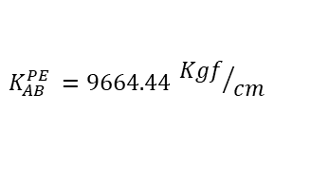
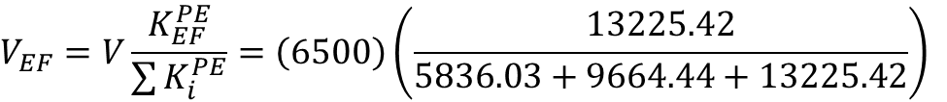
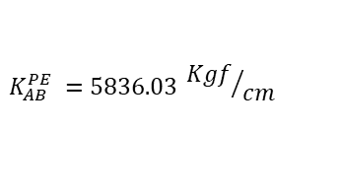
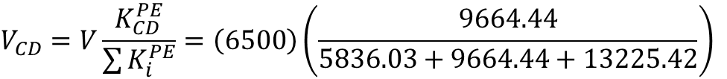

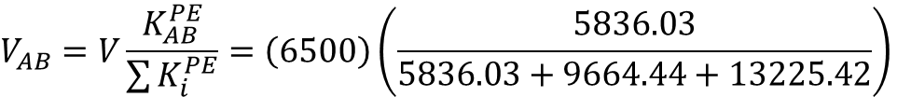

1° Determinando el factor de distribución del cortante en cada nivel
6500 Kgf
D
$$V_{i}=V\frac{K_{i}^{PE}}{\sum{K_{i}^{PE}}}$$
B
F
$$V_{AB}=V\frac{K_{AB}^{PE}}{\sum{K_{i}^{PE}}}=\left(6500\right)\left(\frac{5836.03}{5836.03+9664.44+13225.42}\right)$$
$$2.8 m$$
$$V_{AB}=1319.19 Kgf$$
$$V_{CD}=V\frac{K_{CD}^{PE}}{\sum{K_{i}^{PE}}}=\left(6500\right)\left(\frac{9664.44}{5836.03+9664.44+13225.42}\right)$$
A
C
E
$$3.80 m$$
$$4.2 m$$
$$V_{CD}=2184.56 Kgf$$
$$K_{AB}^{PE} =5836.03 {Kgf}/{cm}$$
$$K_{AB}^{PE} =9664.44 {Kgf}/{cm}$$
$$K_{AB}^{PE} =13 225.42 {Kgf}/{cm}$$
$$V_{EF}=V\frac{K_{EF}^{PE}}{\sum{K_{i}^{PE}}}=\left(6500\right)\left(\frac{13225.42}{5836.03+9664.44+13225.42}\right)$$
$$V_{EF}=2996.26 Kgf$$

Slide 5




2° Determinando la rigidez relativa por cada columna
Determinamos el menor valor de las rigideces laterales de las columnas
6500 Kgf
D
B
F
$$K_{AB}^{PE}=5836.03 {Kgf}/{cm}$$
$$\overline{K_{AB}}=\frac{5836.03}{5836.03}=1$$
$$2.8 m$$
$$\overline{K_{CD}}=\frac{9664.03}{5836.03}=1.7$$
A
C
E
$$\overline{K_{CD}}=\frac{13225.42}{5836.03}=2.3$$
$$3.80 m$$
$$4.2 m$$
$$K_{AB}^{PE} =5836.03 {Kgf}/{cm}$$
$$K_{AB}^{PE} =9664.44 {Kgf}/{cm}$$
$$K_{AB}^{PE} =13 225.42 {Kgf}/{cm}$$

Slide 6

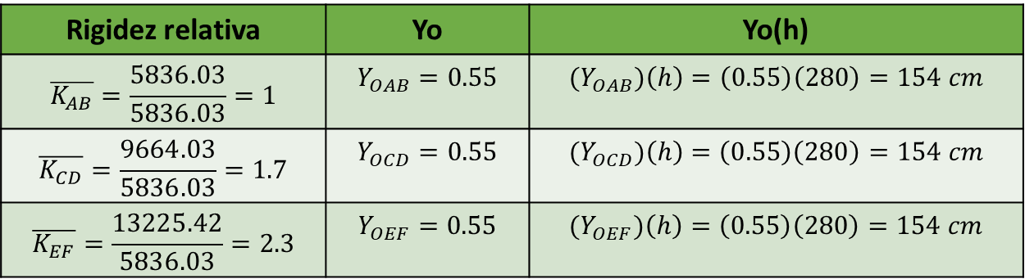
3° Determinando el coeficiente Yo y el punto de inflexión en cada columna
Determinamos el menor valor de las rigideces laterales de las columnas
$$K_{AB}^{PE}=5836.03 {Kgf}/{cm}$$
Rigidez relativa | Yo | Yo(h)
$$\overline{K_{AB}}=\frac{5836.03}{5836.03}=1$$ | $$Y_{OAB}=0.55$$ | $${(Y}_{OAB})\left(h\right)=\left(0.55\right)\left(280\right)=154 cm$$
$$\overline{K_{CD}}=\frac{9664.03}{5836.03}=1.7$$ | $$Y_{OCD}=0.55$$ | $${(Y}_{OCD})\left(h\right)=\left(0.55\right)\left(280\right)=154 cm$$
$$\overline{K_{EF}}=\frac{13225.42}{5836.03}=2.3$$ | $$Y_{OEF}=0.55$$ | $${(Y}_{OEF})\left(h\right)=\left(0.55\right)\left(280\right)=154 cm$$

Slide 7
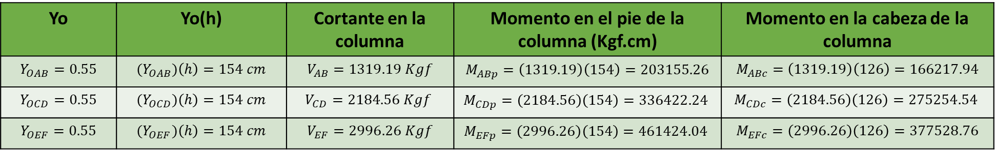
4° Determinando los momentos en las columnas
Yo | Yo(h) | Cortante en la columna | Momento en el pie de la columna (Kgf.cm) | Momento en la cabeza de la columna
$$Y_{OAB}=0.55$$ | $${(Y}_{OAB})\left(h\right)=154 cm$$ | $$V_{AB}=1319.19 Kgf$$ | $$M_{ABp}=\left(1319.19\right)\left(154\right)=203155.26$$ | $$M_{ABc}=\left(1319.19\right)\left(126\right)=166217.94$$
$$Y_{OCD}=0.55$$ | $${(Y}_{OCD})\left(h\right)=154 cm$$ | $$V_{CD}=2184.56 Kgf$$ | $$M_{CDp}=\left(2184.56\right)\left(154\right)=336422.24$$ | $$M_{CDc}=\left(2184.56\right)\left(126\right)=275254.54$$
$$Y_{OEF}=0.55$$ | $${(Y}_{OEF})\left(h\right)=154 cm$$ | $$V_{EF}=2996.26 Kgf$$ | $$M_{EFp}=\left(2996.26\right)\left(154\right)=461424.04$$ | $$M_{EFc}=\left(2996.26\right)\left(126\right)=377528.76$$

Slide 8









4° Determinando los momentos en las columnas
$$166217.94 Kgf.cm$$
$$275254.54 Kgf.cm$$
F
$$377528.76 Kgf.cm$$
B
D
$$2.8 m$$
A
C
E
$$203155.26 Kgf.cm$$
$$336422.24Kgf.cm$$
$$461424.04Kgf.cm$$
$$3.80 m$$
$$4.2 m$$

Slide 9





5° Determinando los momentos en las vigas
$$166217.94 Kgf.cm$$
$$275254.54 Kgf.cm$$
F
$$377528.76 Kgf.cm$$
B
D
Nudo B
$$2.8 m$$
$$166217.94 Kgf.cm$$
A
C
E
$$166217.94 Kgf.cm$$
$$203155.26 Kgf.cm$$
$$336422.24Kgf.cm$$
$$461424.04Kgf.cm$$
$$3.80 m$$
$$4.2 m$$

Slide 10


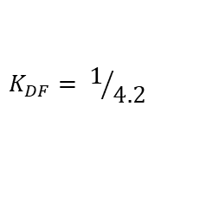
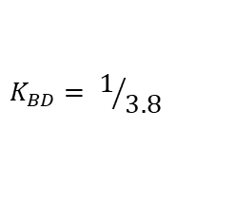

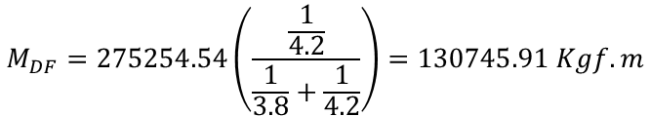

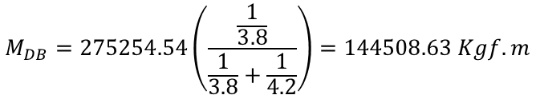
5° Determinando los momentos en las vigas
$$166217.94 Kgf.cm$$
$$275254.54 Kgf.cm$$
F
Nudo D
B
D
$$377528.76 Kgf.cm$$
$$K_{BD}= 1/{3.8}$$
$$K_{DF}= 1/{4.2}$$
$$M_{DB}=275254.54\left(\frac{\frac{1}{3.8}}{\frac{1}{3.8}+\frac{1}{4.2}}\right)=144508.63 Kgf.m$$
$$2.8 m$$
$$M_{DF}=275254.54\left(\frac{\frac{1}{4.2}}{\frac{1}{3.8}+\frac{1}{4.2}}\right)=130745.91 Kgf.m$$
A
C
E
$$203155.26 Kgf.cm$$
$$336422.24Kgf.cm$$
$$461424.04Kgf.cm$$
$$144508.63Kgf.cm$$
$130745.91Kgf.cm$|
$$3.80 m$$
$$4.2 m$$
$$275254.54 Kgf.cm$$

Slide 11


5° Determinando los momentos en las vigas
$$166217.94 Kgf.cm$$
$$275254.54 Kgf.cm$$
F
$$377528.76 Kgf.cm$$
B
D
Nudo F
$$377528.76Kgf.cm$$
$$2.8 m$$
$$377528.76Kgf.cm$$
A
C
E
$$203155.26 Kgf.cm$$
$$336422.24Kgf.cm$$
$$461424.04Kgf.cm$$
$$3.80 m$$
$$4.2 m$$

Slide 12













6° Grafica final
$$144508.63 Kgf.cm$$
$$377528.76 Kgf.cm$$
$$166217.94 Kgf.cm$$
F
B
$$377528.76 Kgf.cm$$
D
$$275254.54 Kgf.cm$$
$$166217.94 Kgf.cm$$
$$130745.91 Kgf.cm$$
$$2.8 m$$
A
C
E
$$203155.26 Kgf.cm$$
$$336422.24Kgf.cm$$
$$461424.04Kgf.cm$$
$$3.80 m$$
$$4.2 m$$

Slide 13


Slide 14


